Slide 1


MACHINE LEARNING LAB
K-Means Clustering
SuneelA Zafar
School of Electrical Engineering and Computer Science (SEECS), NUST, Pakistan

Slide 2
Features and Labels
Machine Learning consists of a wide variety of techniques that can be classified as Supervised, Unsupervised and Reinforcement Learning etc.
A machine learning dataset essentially contains:
  Features: the input columns in the dataset
  Labels: the output columns in the dataset
After the model is trained on the dataset, it is used to make a prediction (inference)
To make a prediction, the user provides some new values for the features. These values are not from the dataset and are used by the trained model to give the output (prediction)

Slide 3
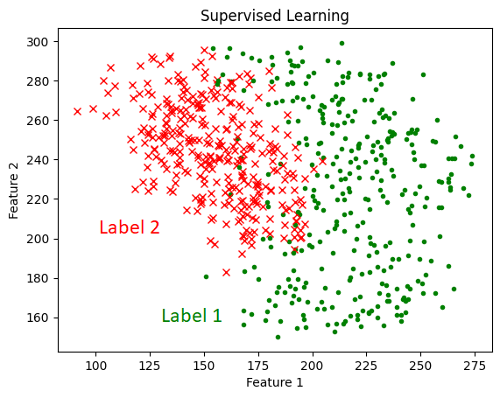
Supervised Learning
Supervised Learning involves datasets that have both features and labels
Examples include Linear Regression, Logistic Regression, Support Vector Machines, Neural Networks etc.

Slide 4
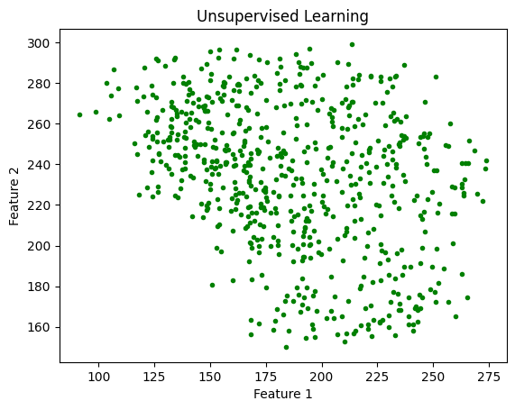
Unsupervised Learning
Unsupervised Learning involves datasets with only features (no labels)
Examples include K-means Clustering, Anomaly Detection and Dimensionality Reduction

Slide 5
Unsupervised Learning
In unsupervised learning, the goal is to find patterns, groups, similarities and structure from the distribution of the dataset features
In this lab, the focus will be solely on K-Means Clustering
Clustering is used widely in
  Search Engines
  Market Segmentation
  Social Network Analysis
  Astronomical Data Analysis
  Image Segmentation

Slide 6
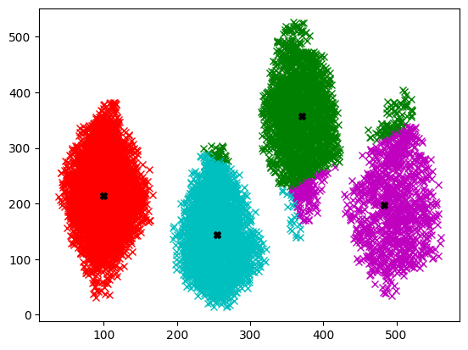
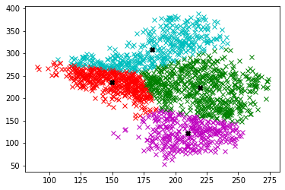
K-Means Clustering
K-Means Clustering is a technique that is used to segment the dataset into various groupings known as “clusters”
The examples below show clustering in which each example point has a certain color showing its cluster. Black dots show the cluster centroids

Slide 7
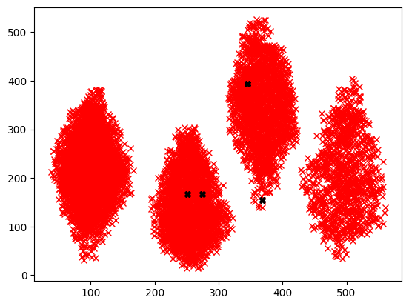
K-Means Clustering
Before clustering starts, the programmer chooses the number of clusters denoted by K
In the example below, K = 4 is chosen; 4 centroids are randomly obtained

Slide 8
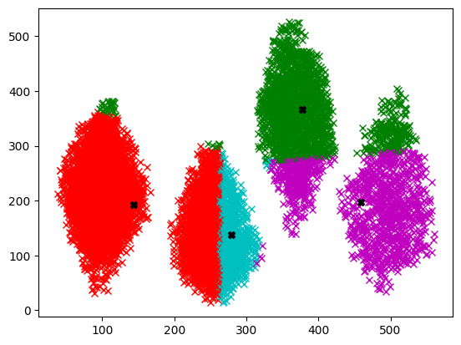
K-Means Clustering
The centroids are iteratively updated using the dataset distribution

Slide 9
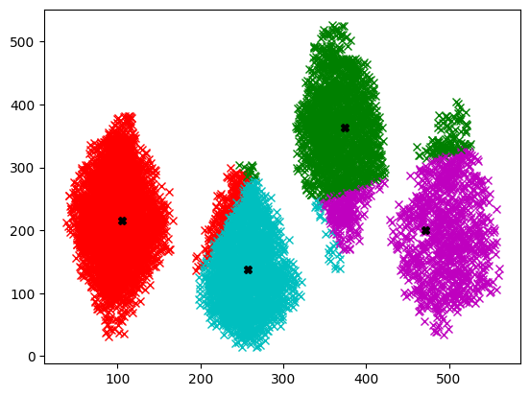
K-Means Clustering
The centroids are iteratively updated using the dataset distribution

Slide 10

K-Means Clustering
The centroids are iteratively updated using the dataset distribution

Slide 11
K-Means Clustering
The centroids are iteratively updated using the dataset distribution
The number of iterations (epochs) is also to be chosen by the programmer

Slide 12
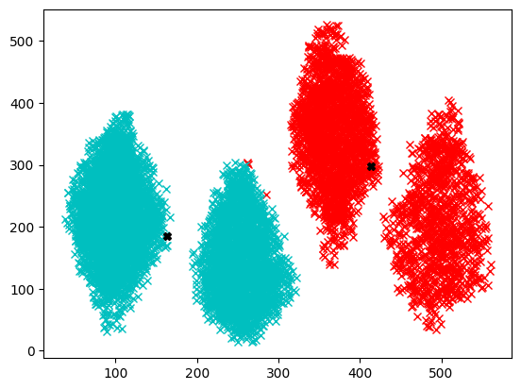
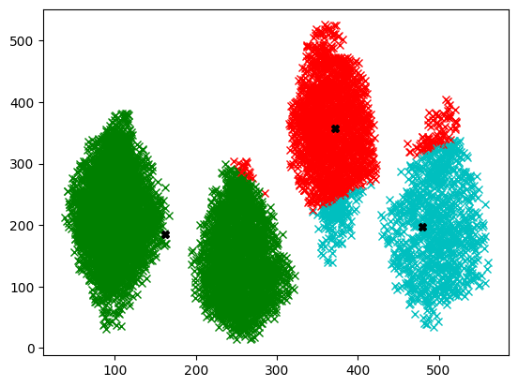
Number of Clusters
K = 2 K = 3

Slide 13
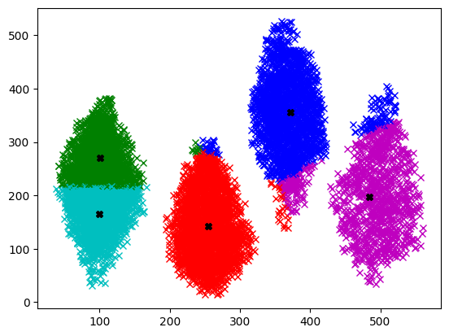
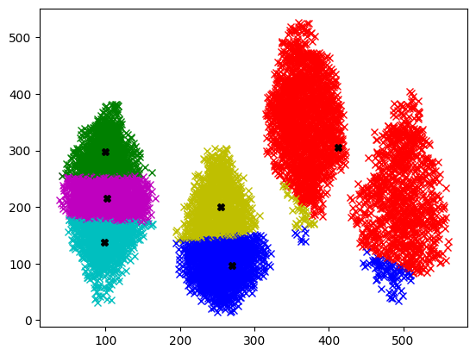
Number of Clusters
K = 5 K = 6

Slide 14
Number of Clusters
K = 5 K = 6
The best value of K may be found by the “elbow method”

Slide 15
Clustering Algorithm
The pseudocode for K-Means Clustering algorithm is given below:
Before the clustering, you will need to load the dataset X
You will also need to specify the epochs number
specify K number of centroids
randomly initialize K number of centroids u
for j = 1:epochs
for i = 1:m
c(i) = index of closest cluster to training example
for k = 1:K
u(k) = mean of all training examples indexed to k
plot of x1 and x2 clusters

Slide 16
Clustering Algorithm
The pseudocode for K-Means Clustering algorithm is given below:
You can assign the initial centroids u_{K} using random K examples from the dataset
specify K number of centroids
randomly initialize K number of centroids u
for j = 1:epochs
for i = 1:m
c(i) = index of closest cluster to training example
for k = 1:K
u(k) = mean of all training examples indexed to k
plot of x1 and x2 clusters

Slide 17
Clustering Algorithm
The pseudocode for K-Means Clustering algorithm is given below:
The main loop that will run the specified number of epochs
Initially, start with smaller number of epochs to get an idea of how the clustering is proceeding. Opt for larger values later if needed
specify K number of centroids
randomly initialize K number of centroids u
for j = 1:epochs
for i = 1:m
c(i) = index of closest cluster to training example
for k = 1:K
u(k) = mean of all training examples indexed to k
plot of x1 and x2 clusters

Slide 18
Clustering Algorithm
The pseudocode for K-Means Clustering algorithm is given below:
m : number of training examples in the dataset
c(i) : vector used to store indices and has length equal to m
specify K number of centroids
randomly initialize K number of centroids u
for j = 1:epochs
for i = 1:m
c(i) = index of closest cluster to training example
for k = 1:K
u(k) = mean of all training examples indexed to k
plot of x1 and x2 clusters

Slide 19
Clustering Algorithm
The pseudocode for K-Means Clustering algorithm is given below:
In this loop, you go through each training example one-by-one and determine which of the centroids is closest to each example
The index of the closest centroid (1, 2, 3 … K) is stored in the c(i) vector
specify K number of centroids
randomly initialize K number of centroids u
for j = 1:epochs
for i = 1:m
c(i) = index of closest cluster to training example
for k = 1:K
u(k) = mean of all training examples indexed to k
plot of x1 and x2 clusters

Slide 20
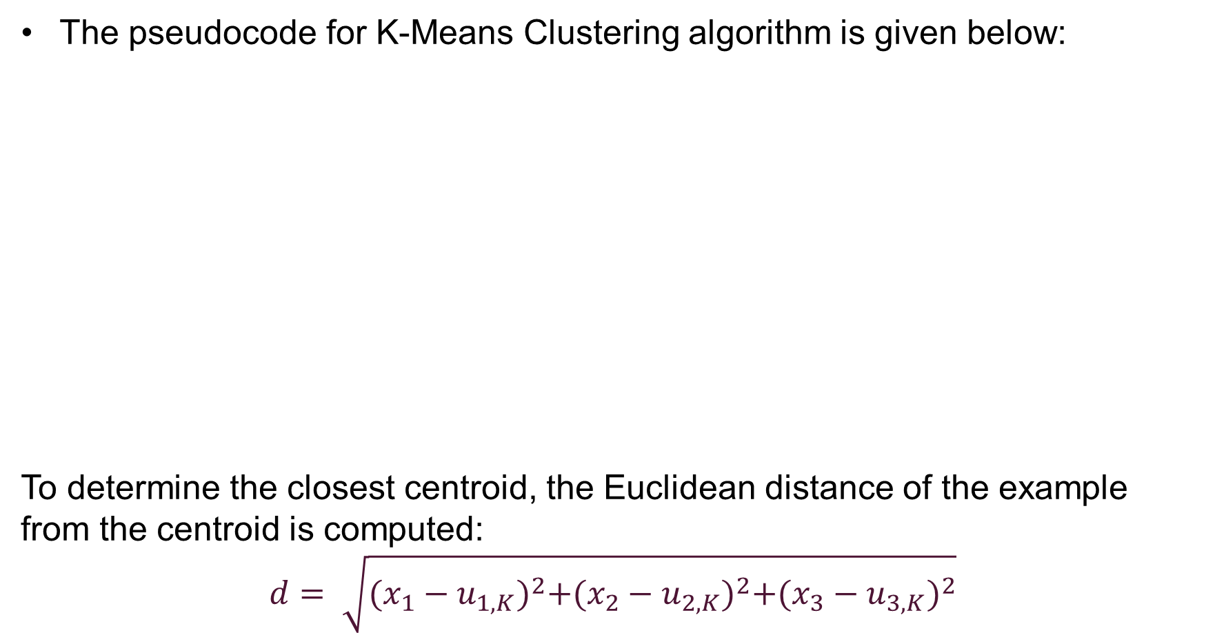
Clustering Algorithm
The pseudocode for K-Means Clustering algorithm is given below:
To determine the closest centroid, the Euclidean distance of the example from the centroid is computed:
$$d= \sqrt{{(x_{1}−u_{1,K})}^{2}+{(x_{2}−u_{2,K})}^{2}+{(x_{3}−u_{3,K})}^{2}}$$
specify K number of centroids
randomly initialize K number of centroids u
for j = 1:epochs
for i = 1:m
c(i) = index of closest cluster to training example
for k = 1:K
u(k) = mean of all training examples indexed to k
plot of x1 and x2 clusters

Slide 21
Clustering Algorithm
The pseudocode for K-Means Clustering algorithm is given below:
After completing the c(i) vector, it is used to update the centroid positions
Notice this loop iterates through each of the K clusters
The training examples that belong to a particular cluster are averaged to give the new centroid point for that cluster
specify K number of centroids
randomly initialize K number of centroids u
for j = 1:epochs
for i = 1:m
c(i) = index of closest cluster to training example
for k = 1:K
u(k) = mean of all training examples indexed to k
plot of x1 and x2 clusters

Slide 22
Clustering Algorithm
The pseudocode for K-Means Clustering algorithm is given below:
At the end of each iteration (epoch), it is a good idea to plot the clusters
By analyzing the plots at each epoch, we can get a sense of how the algorithm is proceeding and decide if we should change the epoch number and value of K
specify K number of centroids
randomly initialize K number of centroids u
for j = 1:epochs
for i = 1:m
c(i) = index of closest cluster to training example
for k = 1:K
u(k) = mean of all training examples indexed to k
plot of x1 and x2 clusters

Slide 23
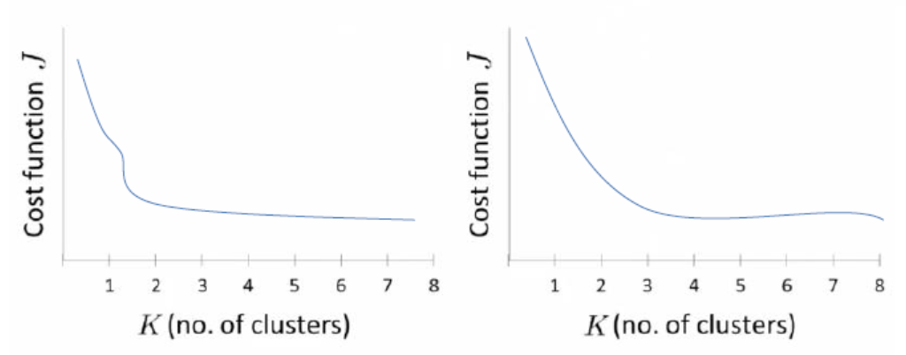
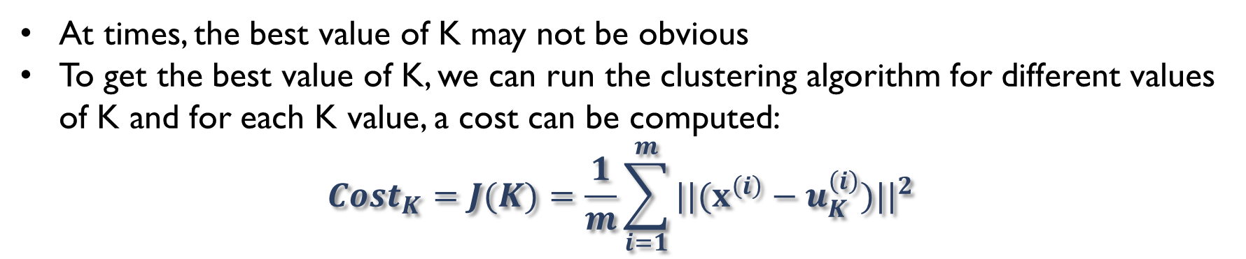
Choosing K Value
At times, the best value of K may not be obvious
To get the best value of K, we can run the clustering algorithm for different values of K and for each K value, a cost can be computed:
$${Cost}_{K}=J(K)=\frac{1}{m}\sum_{i=1}^{m}{{||(x^{\left(i\right)}−u_{K}^{\left(i\right)})||}^{2}}$$
A plot of the cost for each K value can be obtained
By looking at where the “elbow” is, the optimum value of K can be found
Note that this method does not always work

Slide 24
Lab Tasks
Download the Lab Material
Perform the Lab Tasks given in the manual
Submit the saved manual in PDF form
Remember to delete your manual after completing the lab session

